Slide 1
Large Language Models for Generative AI
AIML* ZG536
Dr. Monali Mavani

Slide 2

Large Language Models for Generative AI
Disclaimer and Acknowledgement
The content for these slides has been obtained from books and various other source on the Internet
I here by acknowledge all the contributors for their material and inputs.
I have provided source information wherever necessary
I have added and modified the content to suit the requirements of the course

Slide 3
Agenda
LLM Pre-training
Pre-training Objectives
Pre-training Data
Continuous Pre training (CPT) and Domain Adaptation
Scaling Laws
Pretraining of popular frontier models

Slide 4
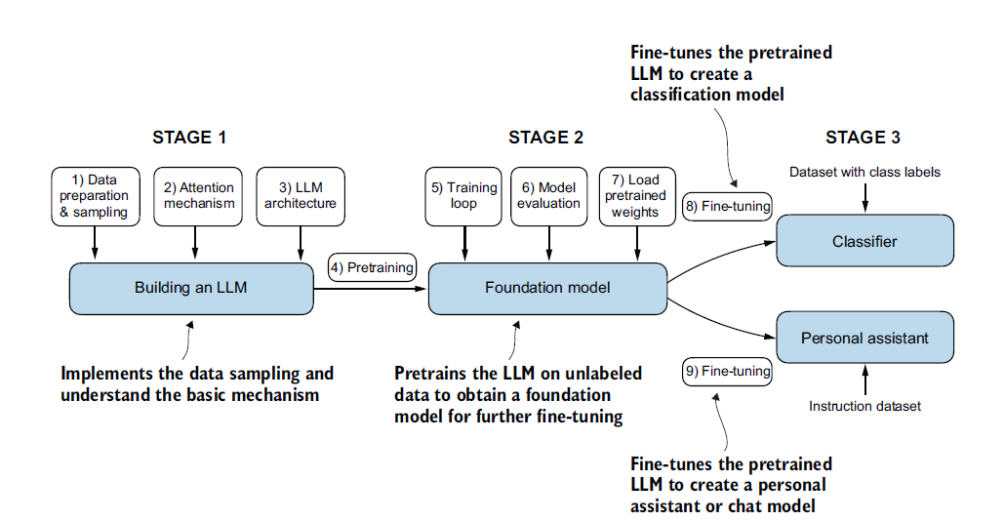
Building a large language model

Slide 5
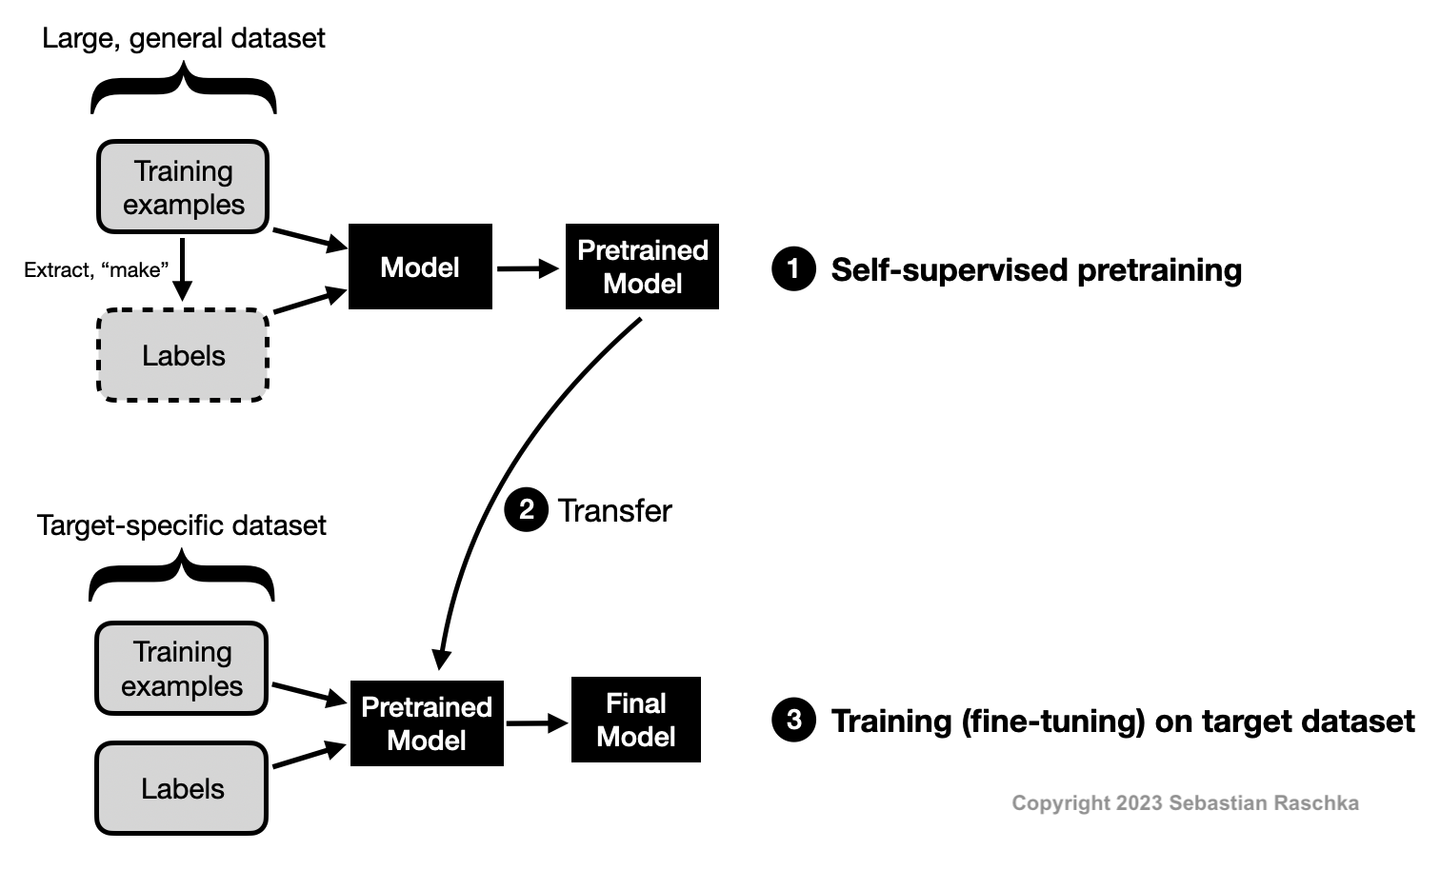
Self-Supervised Learning
Model learns the structure of language simply by reading vast amounts of text and trying to predict the next word (GPT) or fill in the blank(BERT)
It requires no human labeling because the "correct answer" is always just the next word in the sentence
We find a way to obtain labels from the dataset’s structure to formulate a prediction task for the neural network
These self-supervised training tasks are also called pretext tasks.
https://sebastianraschka.com/faq/docs/self-supervised.html

Slide 6
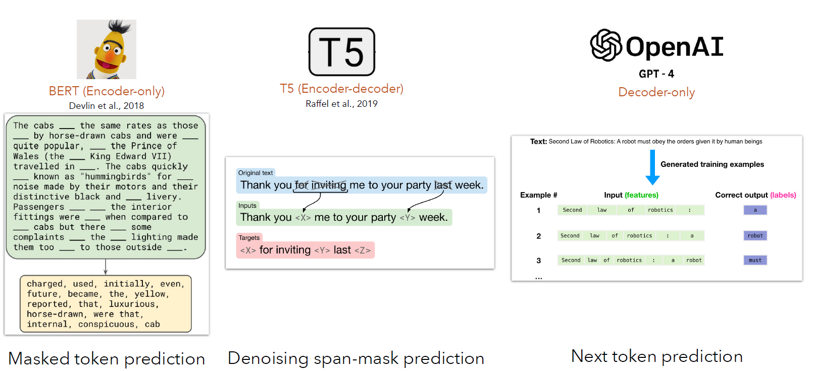
Pre-training Objectives
Masked Language Modeling (MLM)
Causal Language Modeling (CLM)
Credits : https://taoyds.github.io/courses/comp3361

Slide 7
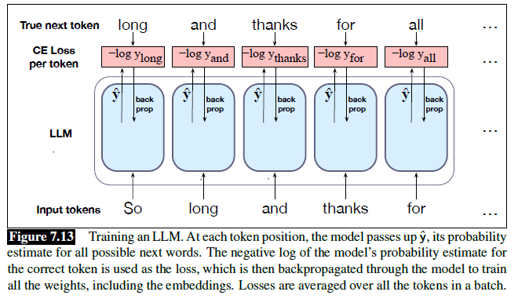
LLM training

Slide 8
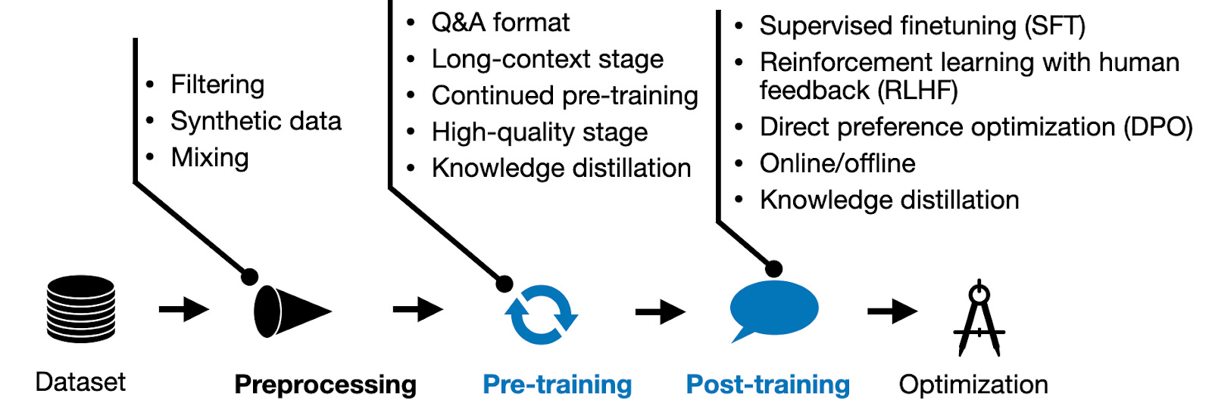
Modern LLM development and training pipeline
Credits: https://magazine.sebastianraschka.com/p/new-llm-pre-training-and-post-training

Slide 9
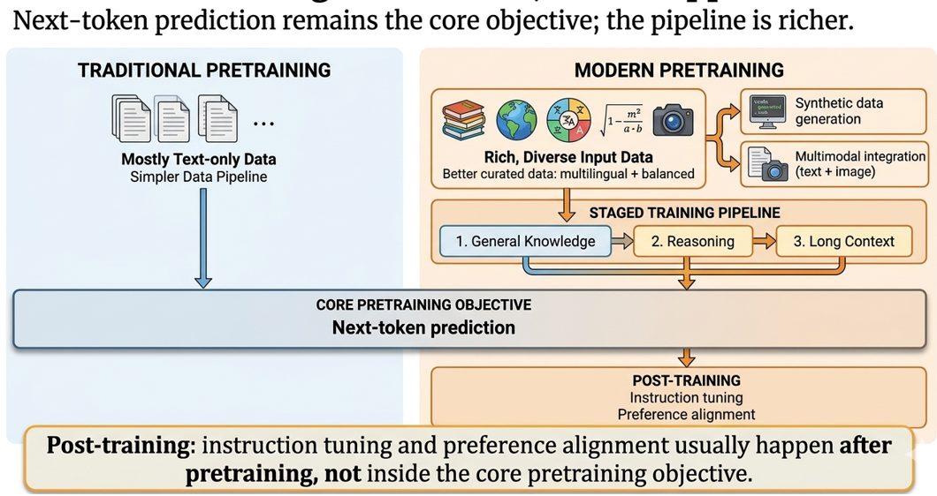
Modern pre-training

Slide 10
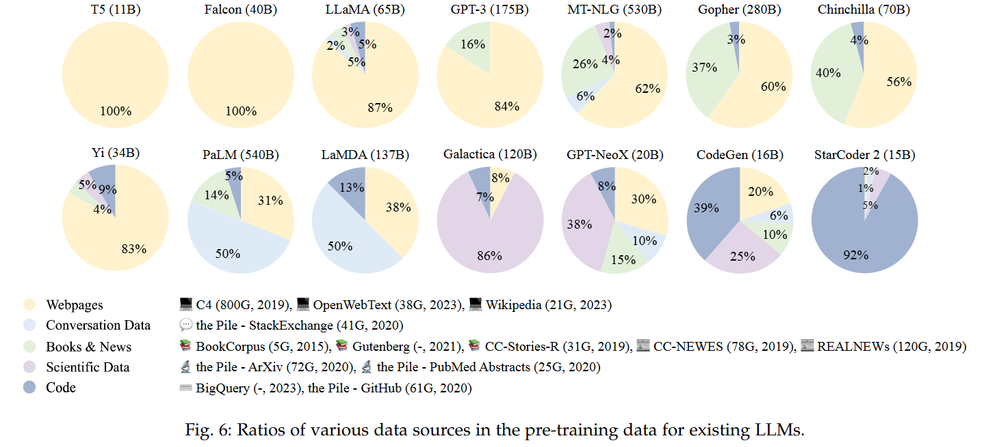
Data mixture
Two levels
  Global level (i.e., the distribution of the entire pre-training data)
  Locally set to varied proportions at different training stages
Llama 3
Knowledge cutoff end of 2023
Downsample data categories that are over-represented on the web, for example, arts and entertainment

Slide 11
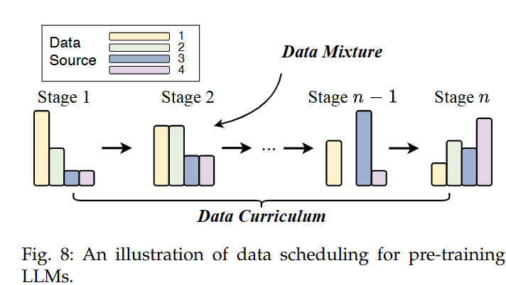
Data Curriculum
It aims to organize different parts of pre-training data for LLMs in a specific order, e.g., starting with easy/general examples and progressively introducing more challenging/specialized ones
Llama 3
  Data annealing improved the performance of a pre-trained Llama 3 8B model
  improvements on the 405B model are negligible

Slide 12
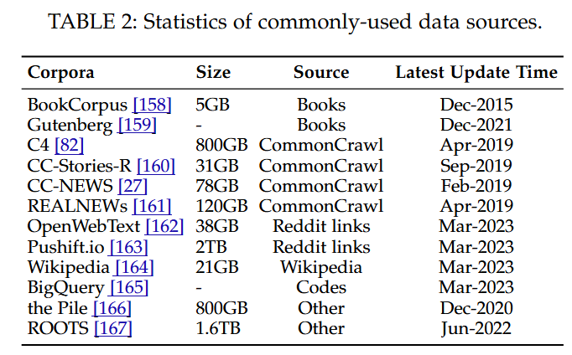
Commonly Used Corpora for Pre-training

Slide 13
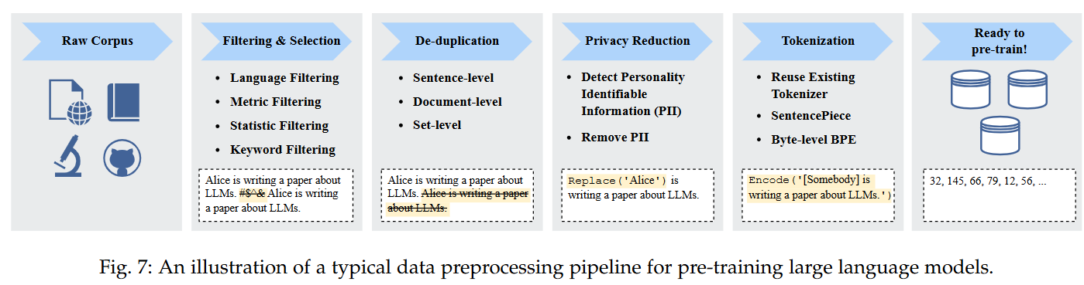
Data Preprocessing pipeline
De-duplication
  Low-quality sentences that contain repeated words and phrases
  words and n-grams overlap between documents to detect and remove duplicated documents
  Helps in dataset contamination problem (overlap between the training and evaluation sets)

Slide 14
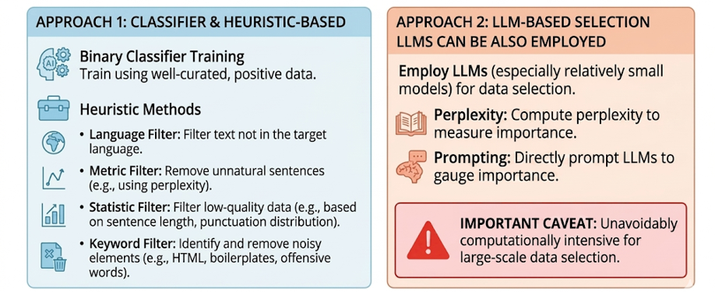
Data Filtering and Selection

Slide 15
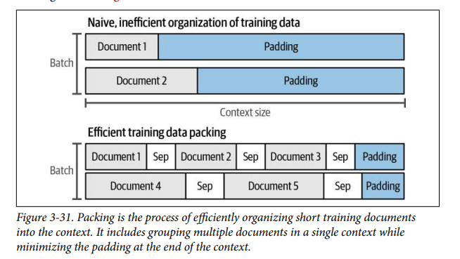
Data Packing

Slide 16

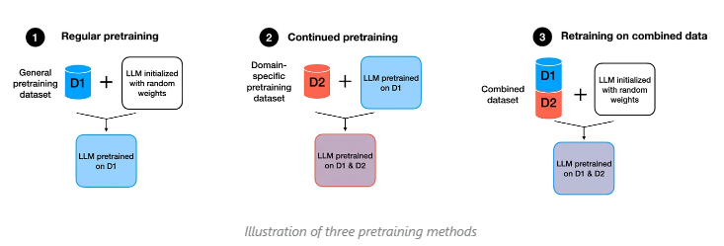
Continued Pre-training (CPT)
Regular pretraining: Initializing a model with random weights and pretraining it on dataset D1.
Continued pretraining: Taking the pretrained model from the scenario above and further pretraining it on dataset D2.
Retraining on the combined dataset: Initializing a model with random weights, as in the first scenario, but training it on the combination (union) of datasets D1 and D2.
https://magazine.sebastianraschka.com/p/tips-for-llm-pretraining-and-evaluating-rms

Slide 17
Catastrophic forgetting
Neural network, especially in sequential learning tasks, forgets previously learned information upon learning new information
Particularly problematic in models trained across diverse datasets or tasks over time
How to Mitigate It
  Lower learning rate — small weight updates preserve old knowledge
  LR warmup — gradual ramp prevents aggressive early overwriting
  Data mixing — blend new domain data with small % of original pretraining data (replay)
  EWC (Elastic Weight Consolidation) — selectively slows learning on weights critical to old tasks by adding penalty in loss term
  LoRA / PEFT — fine-tune only small adapter weights, leaving base weights frozen

Slide 18
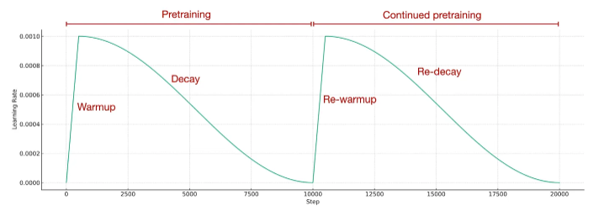
LR warmup
Employ the exact same learning rate schedule that was used during the initial pre training stage
https://magazine.sebastianraschka.com/p/tips-for-llm-pretraining-and-evaluating-rms

Slide 19
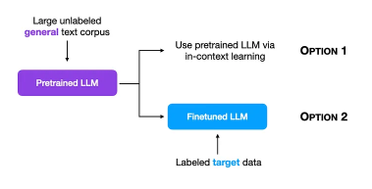
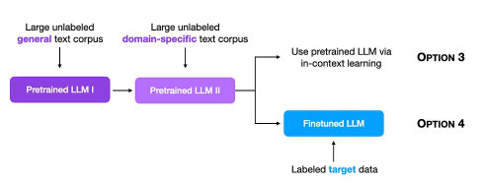
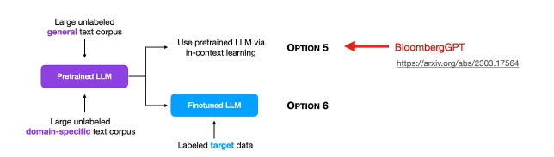
Domain Adaptation
Regular Pre-training (from scratch)
Continue Pre-training (CPT) e.g. FinLlama
Domain-Specific Pre-training (from scratch)

Slide 20
Domain Adaptation
Domain-Specific Pre-training (from scratch)
Continue Pre-training (CPT)
FinLLaMA is an 8B parameter model for financial analysis
Base Model: Meta Llama 3 (8B). It inherits the massive general-knowledge reasoning of Llama 3 from the start
CPT Strategy: Trained on a 52B token financial corpus
To prevent Catastrophic Forgetting, it was trained on a mixture of 52B financial tokens and 18B general-domain tokens (a roughly 75/25 split)
BloombergGPT is a 50B parameter language model for finance, trained on 363B tokens from finance data and 345B tokens from a general, publicly available dataset
Adopted Chinchilla scaling laws (found 50B parameter be a good size given the available size of the finance data)

Slide 21
Model case studies

Slide 22
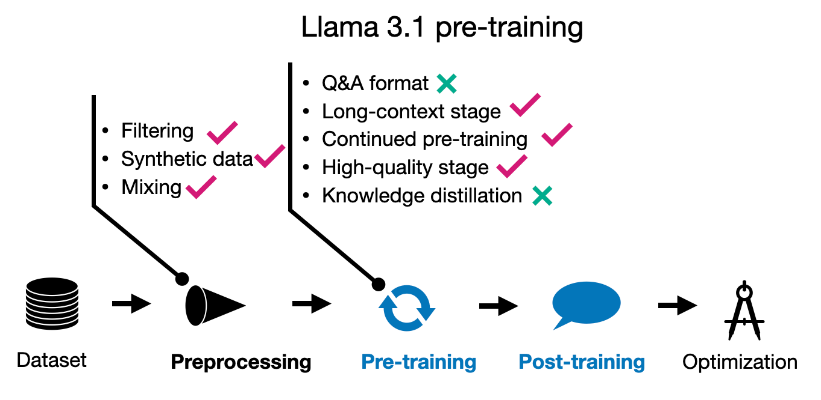
Llama 3 Models: 3-stage pretraining process
Credits: https://magazine.sebastianraschka.com/p/new-llm-pre-training-and-post-training

Slide 23
Llama 3 Models: 3-stage pretraining process
Initial pre-training : Stability through Gradual Scaling
  Dynamic Batch Size & Sequence Length:
    Phase 1: 4M token batch size / 4,096 sequence length (Early stability).
    Phase 2: 8M token batch size / 8,192 sequence length (Scaling up).
    Phase 3: 16M token batch size / 8,192 sequence length (Final throughput)
  Stable standard AdamW instead of more aggressive optimizers
long-context pre-training
  Increased context length gradually in six stages, starting from the original 8K context window and ending in the final 128K context window, using approx. 800B training tokens
(3) Annealing
  Practice of training a model on a small, ultra-high-quality subset of data during the final stages of its pre-training, usually while simultaneously decaying the learning rate to near zero. (Llama 3 used on math and code data)
  Annealing dataset size was 40 billion tokens (0.02% of the total dataset size); this 40B annealing dataset was used to assess data quality. The actual annealing was done only on 40 million tokens (0.1% of the annealing data).

Slide 24
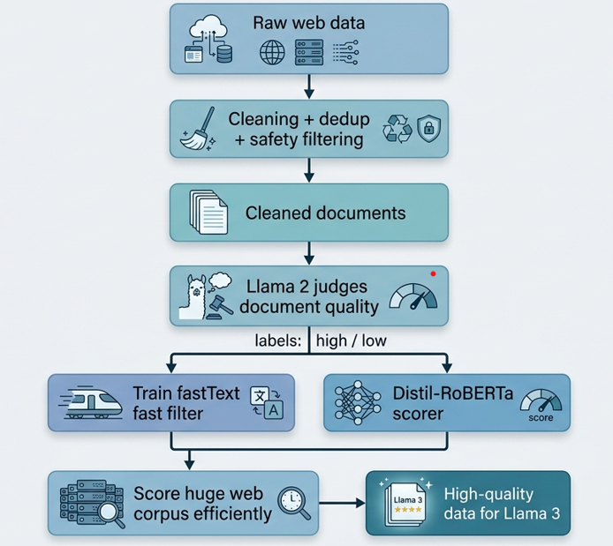
Model-as-a-Judge for data curation (Llama 3)
Llama 3 used model-based data curation to filter large amounts of public web data before pretraining.
Meta combined heuristic filters, semantic deduplication, and learned text-quality classifiers to keep higher-quality training data.
A fast early-pass classifier based on fastText was used to identify text that looked more like content that would be referenced by Wikipedia.
Meta also trained stronger RoBERTa-family quality classifiers using supervision generated by Llama 2.
For efficient large-scale scoring, Meta used DistilRoBERTa to assign quality scores to documents.

Slide 25
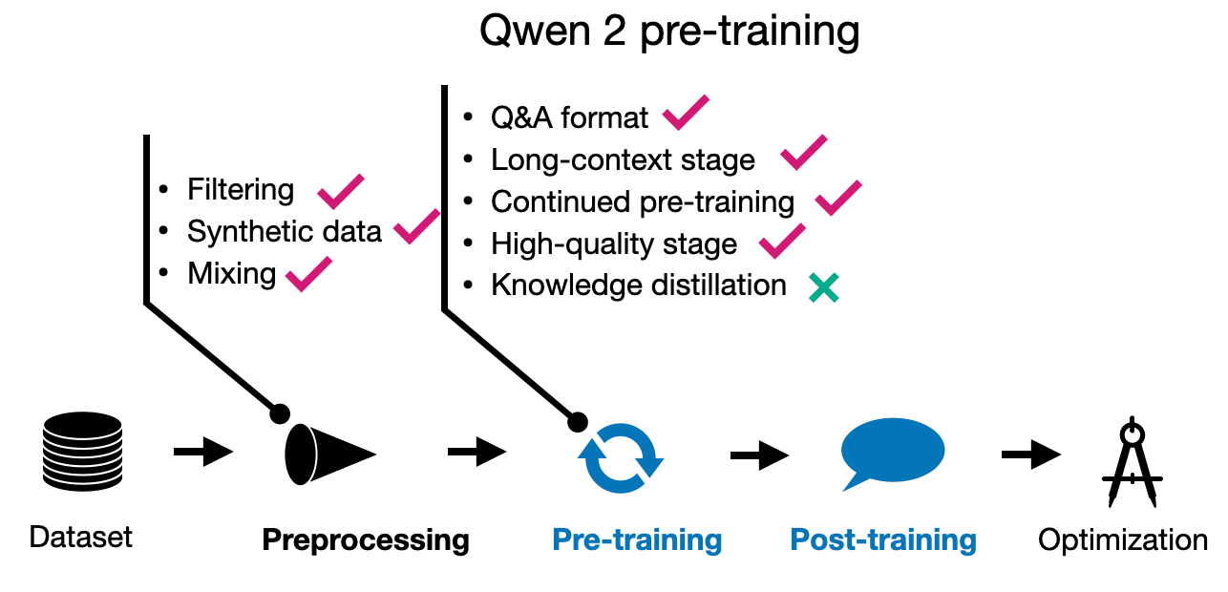
Qwen 2 pretraining
Use of previous generation Qwen models to synthesize additional pre-training data.
pre-training involved “multi-task instruction data to enhance in-context learning and instruction-following abilities
Training in two stages: regular pre-training followed by long-context training
context length from 4,096 to 32,768 tokens at the end phase of pre-training using "high-quality, lengthy data
Credits: https://magazine.sebastianraschka.com/p/new-llm-pre-training-and-post-training

Slide 26
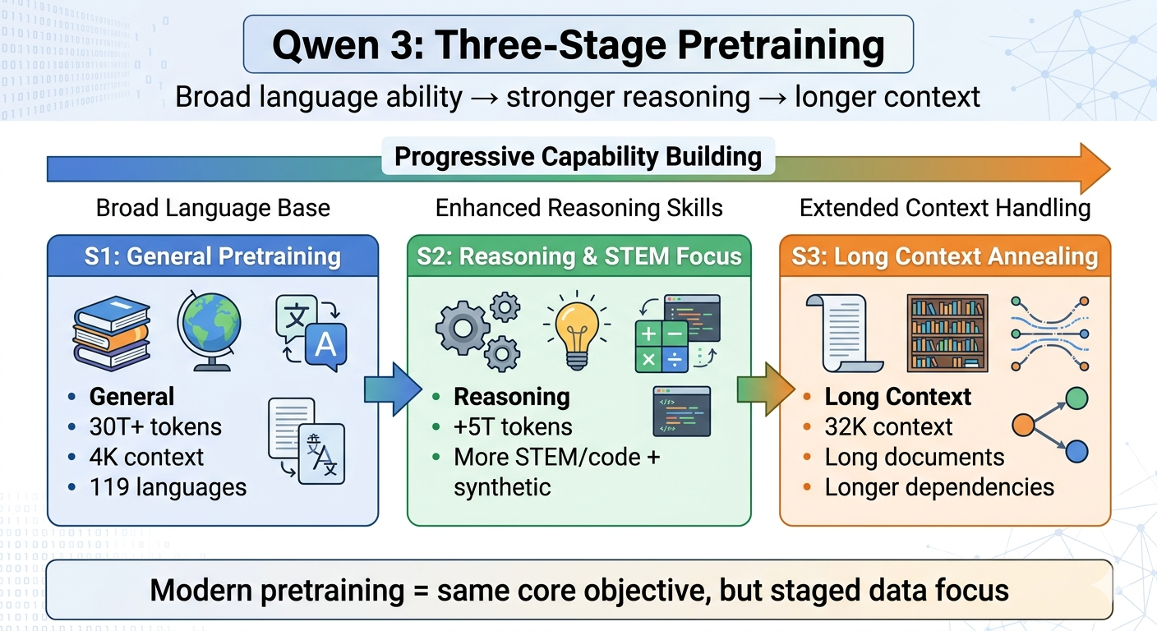
Qwen 3 : 3-stage pretraining process
High quality long context corpus includes 75% of text between 16,384 to 32,768 tokens in length, and 25% of text between 4,096 to 16,384 in length

Slide 27
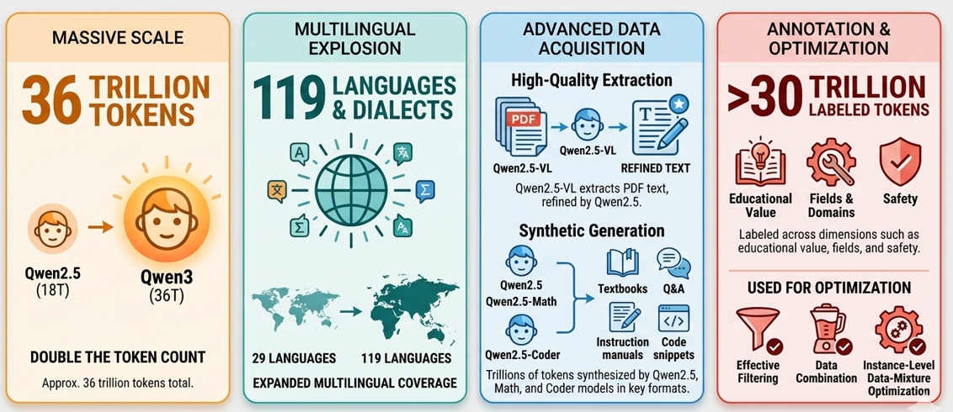
Qwen3 Pretraining Data

Slide 28
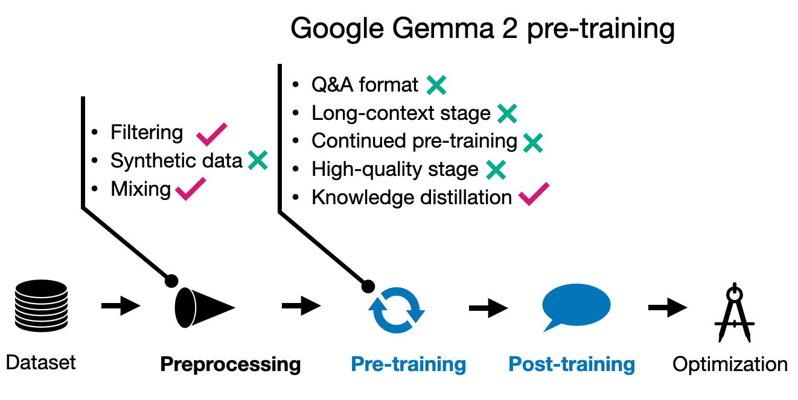
Gemma 2 pre training
Small models are often undertrained
They focus on maintaining quality and achieve improvements through knowledge distillation rather than simply increasing the size of the training dataset
27B Gemma 2 model was trained from scratch
Smaller models were trained using knowledge distillation
Credits: https://magazine.sebastianraschka.com/p/new-llm-pre-training-and-post-training

Slide 29
Gemma 4
Deployable multimodal long-context pretraining
Released in 2026 as open-weight pre-trained and instruction-tuned models
Pre-trained (Base) Models
  Trained on a massive, diverse dataset (web documents, code, math, images, audio) to understand language patterns and multimodal data.
  Designed for developers who wish to perform further specialized training (pre-training on new data or complex fine-tuning)
Instruction-Tuned Models
  Base models further trained on human-annotated data to follow instructions, engage in multi-turn conversations, and use system prompts.
  Native support for function-calling, structured JSON output, and safety filters
large-scale multilingual (140 languages), multimodal pretraining corpus

Slide 30
Scaling laws

Slide 31
Scaling Laws
What can we scale?
  Model size (number of parameters not counting embeddings)
  Dataset size
  Amount of total compute used during training (e.g., number of training steps)
Relationships between these factors and performance are known as scaling laws
Performance of a large language model (loss) scales as a power-law with each of these three properties of model training
Given a fixed compute budget, what is the optimal model size and training dataset size for training a Transformer LM?
Let’s say you can use one GPU for one day
Would you train a 5 million parameter LM on 100 books?
What about a 500 million parameter LM on one book?
Or a 100k parameter LM on 5k books?
Adopted from UMass CS685 slides

Slide 32
Scaling laws
Quantitative approach to characterizing the scaling (model size, data size, and total compute) effect
Scaling laws can be used to instruct the training of LLMs
Predictable scaling : estimate the performance of larger models based on that of smaller models
E.g. Llama 3 used Scaling law experiments to determine the best data mix. Train several small models on a data mix and use that to predict the performance of a large model on that mix

Slide 33
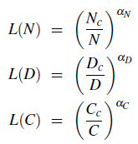
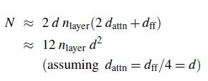
Scaling Laws - Kaplan et al., 2020
L = loss
N = No. of non-embedding parameters
D= dataset size,
C =compute budget
d = model's hidden dimension
Nc, Dc, Cc: constants (scaling coefficients)
Performance depends strongly on scale, weakly on model shape (e.g., depth, width)
if you’re able to increase your compute budget, you should prioritize increasing model size over data size
Led to the creation of very large models trained on relatively small datasets (e.g., GPT-3, 300B tokens)
GPT-3
n = 96 layers
d = 12288
N = 12 x 96 x 12288²
~ 175 billion parameters

Slide 34
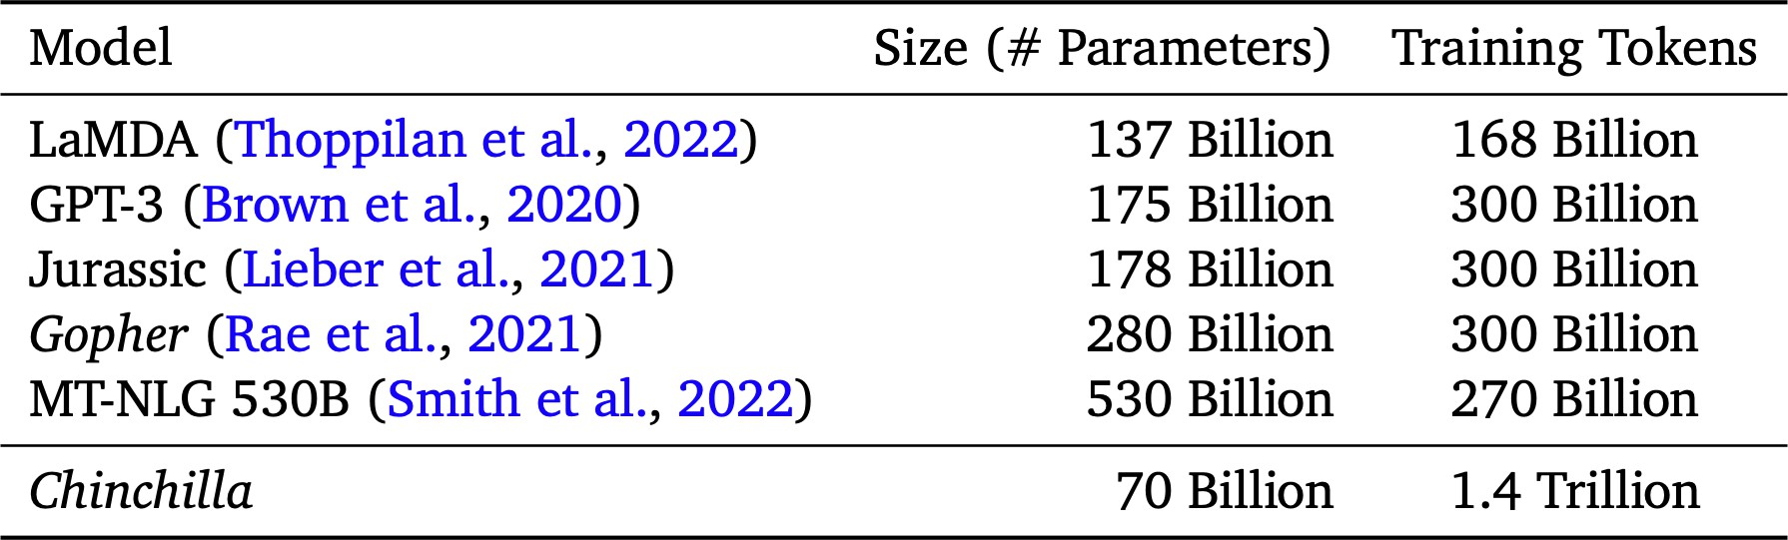
Scaling Laws - Hoffmann et al., 2022 (Chinchilla )
Kaplan laws
  With a 10x compute increase, you should increase model size by 5x and data size by 2x
Chinchilla : you should increase model and data size at the same rate
  With a 10x compute increase, you should increase both model size and data size by 3.1x
  Showed that existing large models were "undertrained" and that smaller models with more data could perform better.
  The Rule of Thumb: For every 1 parameter in your model, you should train it on at least 20 tokens of data.
Adopted from UMass CS685 slides

Slide 35
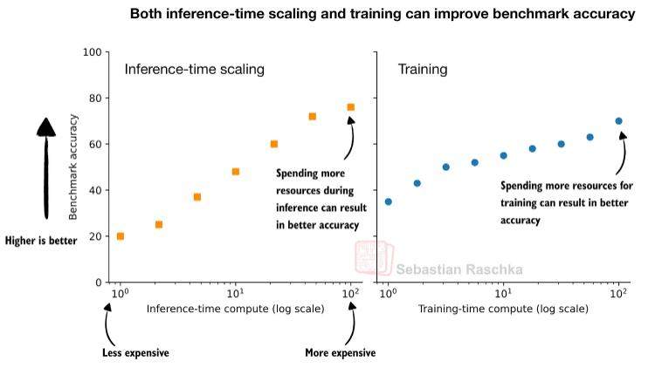
Modern Scaling Laws
Old view: better models come from larger models, more data, and more training compute.
Chinchilla heuristic: about 20 training tokens per parameter.
Example: an 8B model would be “compute-optimal” at about 160B tokens.
Modern practice: Llama 3 models were trained on over 15T tokens, far beyond that heuristic.
New view: accuracy can also improve by spending more compute during inference.
Result: today’s scaling laws involve both pretraining scale and test-time compute.

Slide 36

Emergent abilities of LLMs
“An ability is emergent if it is not present in smaller models but is present in larger models.”
Emergent abilities cannot be predicted simply by extrapolating the performance of smaller models
Ability is emergent when a model has random performance until a certain scale, after which performance increases to well-above random.
Schaeffer et.al.. 2023
Sharpness: Transitioning seemingly instantaneously from not present to present
Unpredictability: Appearing at seemingly unforeseeable model scales
Alleged emergent abilities evaporate with different metrics or with better statistics, and may not be a fundamental property of scaling AI models

Slide 37
Emergent abilities of LLMs
In-context learning: Formally introduced by GPT-3 assuming that the language model has been provided with a natural language instruction and/or several task demonstrations, it can generate the expected output for the test instances by completing the word sequence of input text, without requiring additional training or gradient update
Instruction following: By fine-tuning with a mixture of multi-task datasets formatted via natural language descriptions (called instruction tuning), LLMs are shown to perform well on unseen tasks that are also described in the form of instructions. With instruction tuning, LLMs are enabled to follow the task instructions for new tasks without using explicit examples, thus having an improved generalization ability.
Step-by-step reasoning: For small language models, it is usually difficult to solve complex tasks that involve multiple reasoning steps, e.g., mathematical word problems. In contrast, with the chain-of-thought (CoT) prompting strategy, LLMs can solve such tasks by utilizing the prompting mechanism that involves intermediate reasoning steps for deriving the final answer

Slide 38
References
Speech and Language Processing (3rd ed. draft) Dan Jurafsky Jan 2026 - Ch- 7, 8
Build a Large Language Model (From Scratch) SEBASTIAN RASCHKA : Ch-2,5
https://aws.amazon.com/blogs/machine-learning/an-introduction-to-preparing-your-own-dataset-for-llm-training/
https://huggingface.co/spaces/HuggingFaceTB/smol-training-playbook#introduction
Research Papers
  Scaling Laws for Neural Language Models (Kaplan law)
  Training Compute-Optimal Large Language Models (Chinchilla)
  Emergent Abilities of Large Language Models
  Are Emergent Abilities of Large Language Models a Mirage?
  BloombergGPT:A Large Language Model for Finance
  The Llama 3 Herd of Models
  Qwen3 Technical Report
  A Survey of Large Language Models (https://arxiv.org/pdf/2303.18223)

Slide 39
Extra Slides (not for exam)

Slide 40
GPT-1
Innovations
  Generative Pretraining: GPT-1 introduced the idea of unsupervised pretraining (learning general language representations from large text corpora) followed by supervised fine-tuning on specific tasks.
  Unidirectional Context: GPT-1 only attends to the left context (previous tokens) in a sequence, as opposed to bidirectional models like BERT.
Architecture
  Model Type: Transformer-based decoder model.
  Pre-training type : causal language model
Key Model Parameters
  Number of Layers: 12 transformer blocks (stacked layers).
  Hidden Size: 768-dimensional hidden states in each layer.
  Number of Attention Heads: 12 heads in the multi-head self-attention
  Feedforward Network Size: 3072 (hidden size × 4).
  Number of Parameters: ~117 million total.
  Vocabulary Size: 40,000 tokens (using Byte Pair Encoding)
  Activation function: GELU (Gaussian Error Linear Unit)

Slide 41
GPT-1
Input and Sequence Details
  Data Pre processing : ftfy library to clean the raw text in BooksCorpus, standardize some punctuation and whitespace, and use the spaCy tokenizer.
  Maximum Sequence Length: 512 tokens.
  Longer inputs are truncated, and shorter ones are padded.
  Tokenization: Uses Byte Pair Encoding (BPE)
Positional Encodings : learned positional embeddings instead of sinusoidal
Attention Mechanism
  Self-Attention: Uses scaled dot-product attention.
  Queries, keys, and values are projected into a 64-dimensional space for each head (768 ÷ 12 heads = 64 per head).

Slide 42
GPT-1
Training Setup
  Dataset: BooksCorpus dataset, containing ~7,000 books with ~800 million words.
  Objective: Causal Language Modeling (Next-Token Prediction)
  Loss function: Cross-Entropy Loss.
  Batch Size: 64 sequences per minibatch.
  Sequence Length: 512 tokens per sequence.
  Learning Rate Schedule: Linear warm-up for the first 2000 updates. Cosine decay thereafter.
  Optimizer: Adam optimizer
  100 epochs
  Regularization : attention dropouts with a rate of 0.1 and modified L2 regularization
Output : Uses a softmax layer to generate these probabilities.

Slide 43
GPT-1
Fine tuning
  Same hyperparameter settings from unsupervised pre-training. dropout to the classifier with a rate of 0.1.
  learning rate of 6.25e-5
  batchsize of 32
  3 epochs of training
  We use a linear learning rate decay schedule with warmup over 0.2% of training
  λ = 0.5

Slide 44
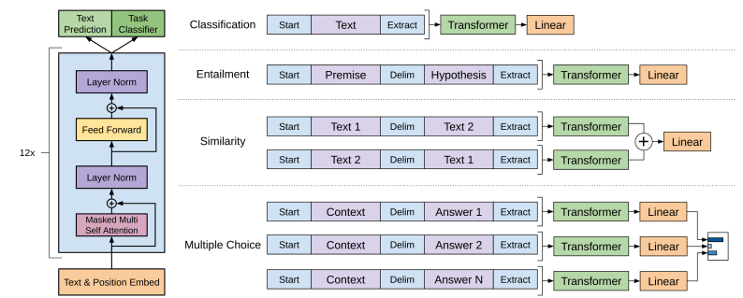
LLM downstream tasks: GPT-1
Format the input using special tokens like Start, Delim (delimiter), and Extract.
Pass this formatted text through the same pre-trained Transformer model.
Take the Transformer's output vector corresponding to the Extract token.
Feed that single vector into a simple Linear layer to get the final answer
Input: <start> This movie was surprisingly emotional, beautifully acted, and worth watching again. <extract>
Output label: Positive
Idea: use the representation of the <extract> token as the feature for classification
The model learns this during fine-tuning on labeled sentiment data

Slide 45
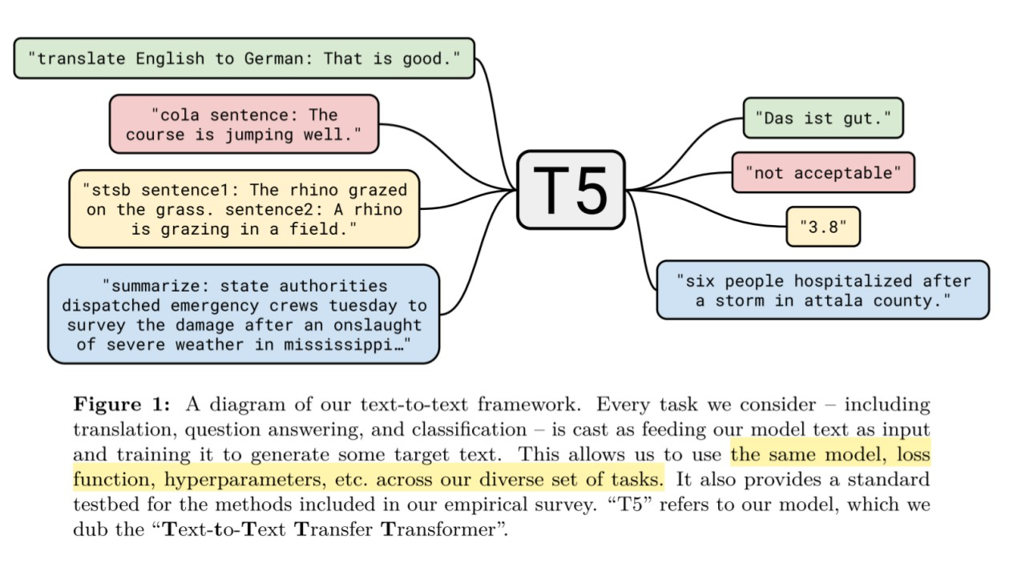
T5 (Text-to-Text Transfer Transformer)
Pre-train a Transformer Encoder-Decoder model on a large unlabeled web crawl text
T5 treats every NLP problem as a text-to-text problem.
Same model, objective, training procedure, and decoding process to every downstream task
Baseline size: two stacks of size BERTBASE
Raffel, C., Shazeer, N., Roberts, A., Lee, K., Narang, S., Matena, M., ... & Liu, P. J. (2020). Exploring the limits of transfer learning with a unified text-to-text transformer. JMLR.

Slide 46
T5 (Text-to-Text Transfer Transformer)
Pre-train a Transformer Encoder-Decoder model on a large unlabeled web crawl text
T5 treats every NLP problem as a text-to-text problem.
Same model, objective, training procedure, and decoding process to every downstream task
Baseline size: two stacks of size BERTBASE
Raffel, C., Shazeer, N., Roberts, A., Lee, K., Narang, S., Matena, M., ... & Liu, P. J. (2020). Exploring the limits of transfer learning with a unified text-to-text transformer. JMLR.

Slide 47
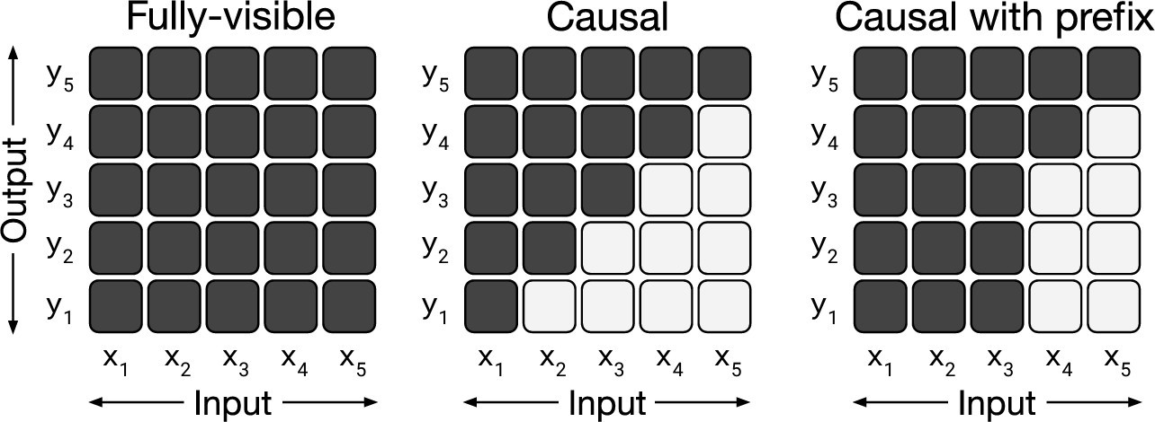
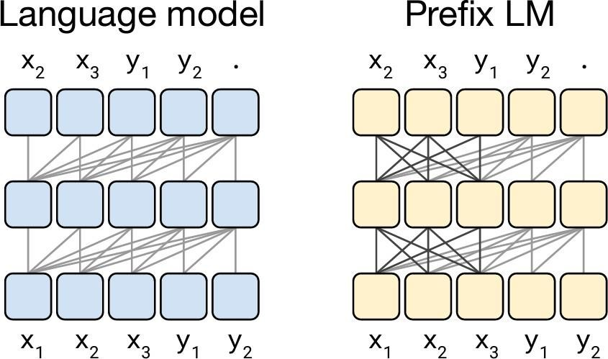
T5 Attention – Prefix LM
A “fully-visible” attention mechanism is placed at the input sequence.
  Input Sequence: translate English to German : That is good . target :
  Target Output: Das ist gut .
  Fully-visible masking would be applied to the prefix “translate English to German: That is good. target:”
  Causal masking during training for predicting the target “Das ist gut.”

Slide 48
T5
Proposed “Colossal Clean Crawled Corpus” (C4) , 750 GB, the Common Crawl-based data set created as a source of unlabeled text data (available as part of TensorFlow Datasets)
English language only (langdetect)
Roughly equivalent to the original Transformer proposed in
“Attention Is All You Need” with the exception
  removing the Layer Norm bias,
  placing the layer normalization outside the residual path,
  Learned relative position embeddings according to the offset between the “key” and “query” being compared in the self-attention mechanism
Consistent training objective (maximum likelihood objective using “teacher forcing”) both for pre-training and fine-tuning.
Baseline size: two stacks of size BERTBASE

Slide 49
T5 - Input-Output
To specify which task the model should perform, a task-specific (text) prefix is added to the original input sequence
Example task :English to German translation
Training datapoint :
  input - “That is good.”
  target - “Das ist gut.”
Input for T5:
  “translate English to German: That is good. target: Das ist gut”
Prefix: “translate English to German: That is good. target:”
Output : “Das ist gut “
Output autoregressively generated

Slide 50
T5- Input-Output
MNLI benchmark example (Multiclass classification with 3 classes ‘entailment’, ‘contradiction’ and ‘neutral’)
    Premise : “I hate pigeons.”
    Hypothesis : “My feelings towards pigeons are filled with animosity.”
    Label: “entailment”
Input for T5: “mnli premise: I hate pigeons. hypothesis: My feelings towards pigeons are filled with animosity. target: entailment”
Prefix: : “mnli premise: I hate pigeons. hypothesis: My feelings towards pigeons are filled with animosity. target:”
Output : “entailment”
Output is analogous to the “classification” token used in BERT
difference between a prefix LM and the BERT architecture is that the classifier is simply integrated into the output layer of the Transformer decoder

Slide 51
T5- Vocabulary
32,000 wordpieces shared across input and output
Pre-training is English, but fine-tuning includes German, French, and Romanian
Trained SentencePiece model 10:1:1:1 English : German : French : Romanian
  Can handle fixed set of languages
51

Slide 52
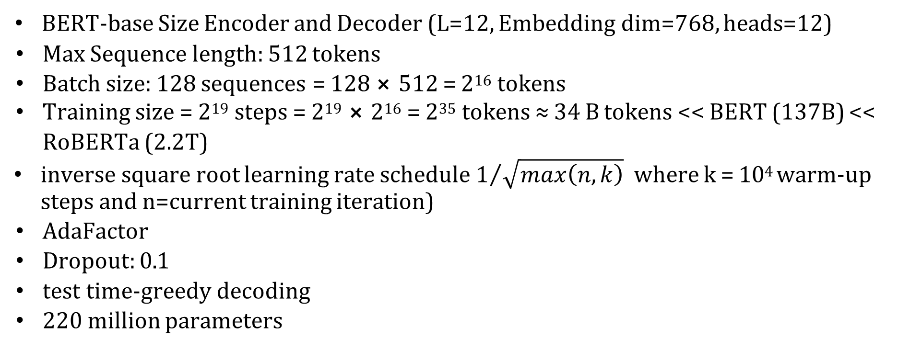
T5- Baseline (Pre-training details)
BERT-base Size Encoder and Decoder (L=12, Embedding dim=768, heads=12)
Max Sequence length: 512 tokens
Batch size: 128 sequences = 128 ⨯ 512 = 2¹⁶ tokens
Training size = 2¹⁹ steps = 2¹⁹ ⨯ 2¹⁶ = 2³⁵ tokens ≈ 34 B tokens << BERT (137B) << RoBERTa (2.2T)
inverse square root learning rate schedule $1/{\sqrt{max\left(n,k\right)}}$ where k = 10⁴ warm-up steps and n=current training iteration)
AdaFactor
Dropout: 0.1
test time-greedy decoding
220 million parameters

Slide 53
T5- Baseline (Fine-tuning Details)
Batch Size: 128
Length: 512
Training size = 2¹⁸ steps = 2¹⁸ ⨯ 2¹⁶ = 2³⁴ tokens
constant learning rate: 0.001
5,000 steps/checkpoint

Slide 54
T5- Fine-tuning (Downstream) tasks
Text classification: GLUE and SuperGLUE (collection of text classification tasks meant to test general language understanding abilities)
Abstractive summarization: CNN/Daily Mail
QA: SQuAD
Translation: WMT English to German, French, and Romanian

